Slide 1

Speaker Recognition
Submitted To:
Mr. Ramesh Kumar
Assistant Professor
CSED
GBPEC
Submitted By:
Brij Mohan Purohit
Arjun Joshi
Ankur Bharti
Ashish Mathur

Slide 2
Overview:
      Introduction
      Motivation
      Objective
      Speaker Recognition Model
      Feature Extraction
      Feature Extraction Implementation
      Conclusion
      Major Problems in Speech Processing
      Future Scope

Slide 3
Introduction:
Speaker recognition: the process of automatically recognizing who is speaking by using the speaker-specific information included in speech sounds.
The main idea in the project is that individuals have resonant frequency patterns and duration patterns that are unique, allowing us to identify the speaker.

Slide 4
Motivation:
The basic motivation for the project “Speaker Recognition” was to recognize a user according to his/her own individual characteristic (like voice, face, iris, finger print etc.) rather than a combination of username and password.
And making the user control their system through voice commands as shown in the Iron Man movie(Jarvis System).

Slide 5
Objective:
The objective of this project is to recognise a speaker by his/her voice.
In this we use:
Sampling of speech
Acoustic signal processing
    Mel Frequency Cepstral Coefficients (MFCC)
    Time Domain Analysis(TDA)

Slide 6
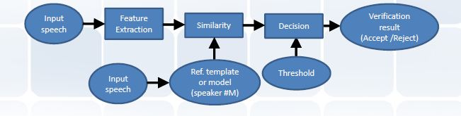
Speaker Recognition Procedure:

Slide 7
Speaker Recognition Model:
Speaker recognition Models
Feature Extraction
Feature Matching

Slide 8
Feature Extraction:
Feature extraction is done to extract a small amount of data from the voice signal that can later be used to represent each speaker.
Input
Speech
Frame
Blocking
frame
Windowing
FFT
spectrum
Cepstrum
Mel-frequency
wrapping
Feature Extraction Model

Slide 9
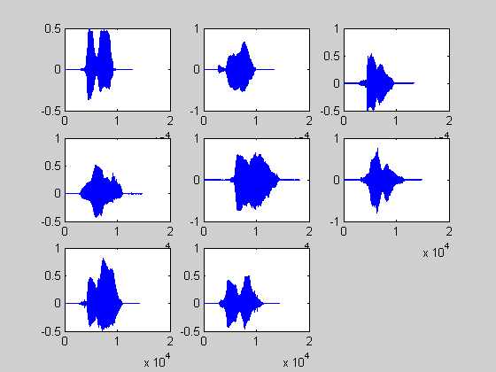
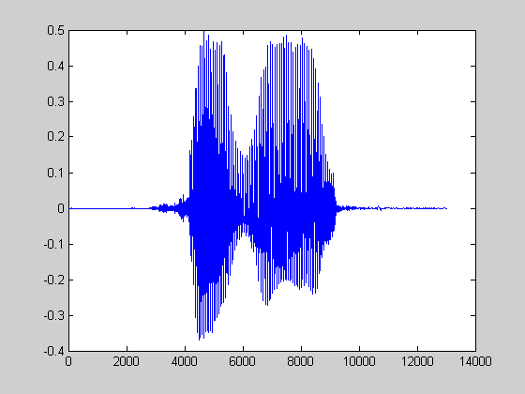
Input Speech:
‘ze’
‘ro’
There are silence at the beginning and at the end of the signals.
The word consists of two syllables.

Slide 10
Frame Blocking:
Input
Speech
Frame
Blocking
frame
Windowing
FFT
spectrum
Cepstrum
Mel-frequency
wrapping
Input speech signal is blocked into frames of N samples with adjacent frames being separated by M(M<N).
Frame1 Consist of First N samples.
Frame2 Begins M samples after first frame, and the overlaps it by N-M samples.

Slide 11
Windowing:
Input
Speech
Frame
Blocking
frame
spectrum
Windowing
FFT
Cepstrum
Mel-frequency
wrapping
For speech processing we want to assume the signal is short-time stationary and perform a Fourier transform on these small blocks. But these blocks have discontinuities on its edges. So we multiply the signal by a window function that is zero outside some defined range.
Obvious advantage: localizing a part of speech for analysis

Slide 12
FFT:
Input
Speech
Frame
Blocking
frame
spectrum
Windowing
FFT
Cepstrum
Mel-frequency
wrapping
In FFT we convert each frame of N samples from time domain into the frequency domain.

Slide 13
Mel – Frequency Wrapping:
Input
Speech
Frame
Blocking
frame
spectrum
Windowing
FFT
Cepstrum
Mel-frequency
wrapping
The speech signal consists of tones with different frequencies.
For each tone with an actual Frequency, f, measured in Hz, a subjective pitch is measured on the ‘Mel’ scale.

Slide 14
Cepstrum:
Input
Speech
Frame
Blocking
frame
spectrum
Windowing
FFT
Cepstrum
Mel-frequency
wrapping
The cepstrum can be seen as information about rate of change in the different spectrum bands.
Convert the log mel spectrum back to Time domain.

Slide 15
Feature Extraction Approaches:
MFCC
TDA

Slide 16
MFCC approach:
MFCC: is based on the known variation of the human ear’s critical bandwidths with frequency, filters spaced linearly at low frequencies and logarithmically at high frequencies.
MFCCs are the coefficient that collectively make up an MFC
In MFC, the frequency bands are equally spaced on the mel-scale which approximates the human auditory system more closely than the linearly spaced frequency bands used in normal spectrum

Slide 17
MFCC approach:
MFCCs are commonly derived as
Take the Fourier transform of a signal (windowed)
Map the powers of obtained signal on to mel-scale, using triangular over lapping windows
Take the logs of the power at each of the mel frequencies
Take the discrete cosine transform of mel powers
The MFCCs are the amplitudes of resulting spectrum

Slide 18
Time Domain Analysis:
The main task of speech analysis is to extract features or parameters from speech signals, represented both in time-domain and frequency-domain.
In this section we will focus on feature extraction via time-domain analysis techniques such as Short-term energy, Zero-crossing rate, Autocorrelation.

Slide 19
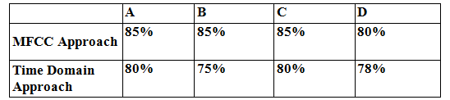
Comparison:
We concluded from our experiments that for an isolated word recognition system like the one we aimed to implement in our project, the MFCC approach proved to be more effective.

Slide 20
Major Problems in Speech Processing:
Acoustic variability: the same phonemes pronounced in different contexts will have different acoustic realization.
The signal is different when speech is uttered in various environments:
    noise
    reverberation
    different types of microphones.
Speaking variability: when the same speaker speaks normally, shouts, whispers, uses a creaky voice, or has a cold.
The rate of speech (fast speech tends to be harder)

Slide 21
Scope:
This project focused on “Isolate word recognition” but idea can be extended to “Continuous word recognition” & create Language Independent Recognition system
Use of statistical models like HMMs, GMMs or learning models like Artificial Neural Network can also enhance the present project. And make system much tolerant & less error prone

Slide 22
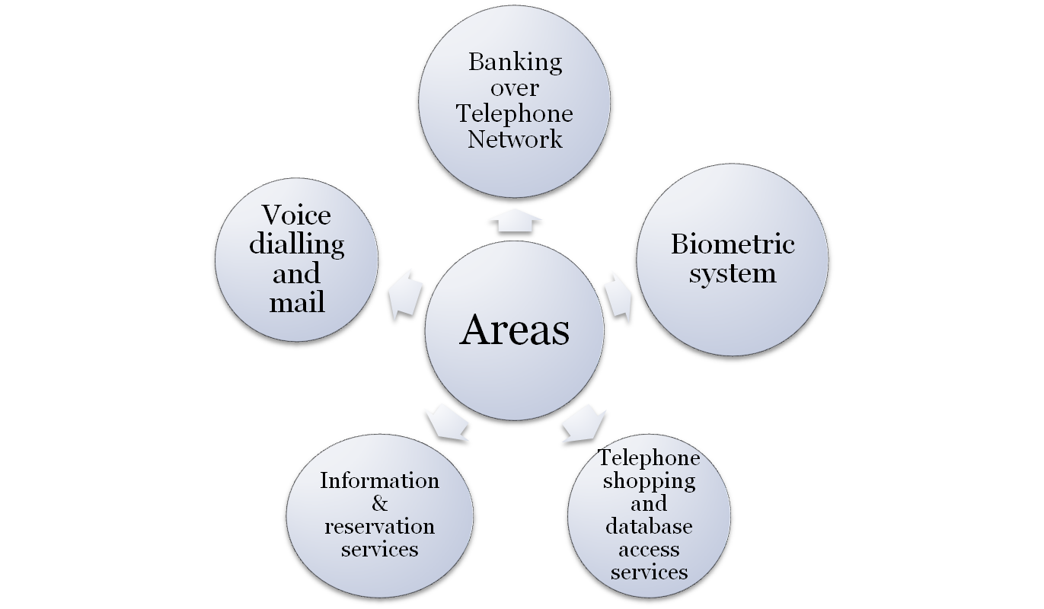
Applications:

Slide 23
References:
Wei Han, Cheong-Fat Chan, Chiu-Sing Choy and Kong-Pang Pun – ‘An Efficient MFCC Extraction Method in Speech Recognition’, Department of Electronic Engineering, The Chinese University of Hong Kong, Hong, IEEE – ISCAS, 2010
Pradeep Kumar P and Preeti Rao – „A Study of Frequency-Scale Warping for Speaker Recognition’, Dept of Electrical Engineering, IIT- Bombay, National Conference on Communications, NCC 2004, IISc Bangalore, Jan 30 -Feb 1, 2006
www.mathwork.com
www.haroon.site11.com

Slide 24
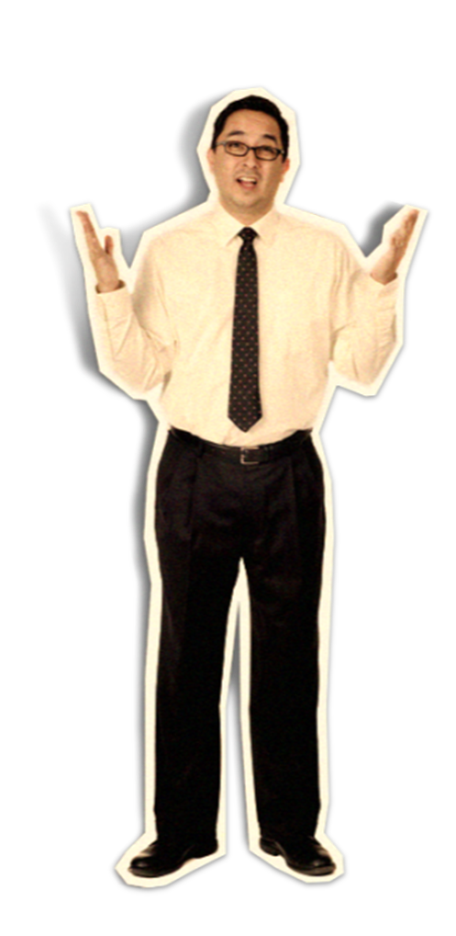
Any Queries???

Slide 25
Thank you :-?

